Slide 1
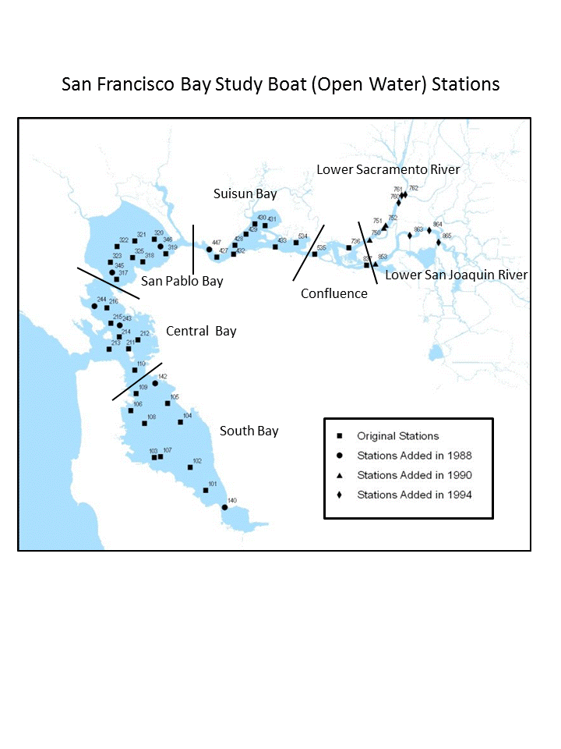
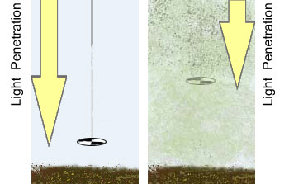
Secchi Depth
Interagency Ecological Program Status & Trends
2017-2018 Winter Season Report
Delta outflow is a major ecosystem driver and depends on natural hydrological variability and water management operations, including exports from the Delta and reservoir operations.
.
Suisun Bay
Organisms in this ecosystem are adapted to high turbidity conditions, and reductions in turbidity can have many negative ecological effects. Higher values for Secchi depth indicate lower turbidity.
Secchi depth is measured monthly by DWR’s Environmental monitoring program by dropping a black-and-white disk in the water until it disappears.
Suisun bay is usually pretty murkey, meaning low secchi depth.
The Delta
San Pablo Bay
The Delta has been getting clearer over time
San Pablo bay is pretty clear.

Slide 2

Temperature
Interagency Ecological Program Status & Trends
2017-2018 Winter Season Report
Delta outflow is a major ecosystem driver and depends on natural hydrological variability and water management operations, including exports from the Delta and reservoir operations.
High Delta outflow causes fresher conditions in San Pablo Bay.
Suisun Bay
Water temperature affects fish and stuff
High temperatures lead to fish not doing so good and some harmfull algal blooms
Climate change will make things worse.
Suisun bay is cool
The Delta
San Pablo Bay
The delta is hot and stuff, but weltands might form thermal refugia
Other fun temperature facts.

Slide 3
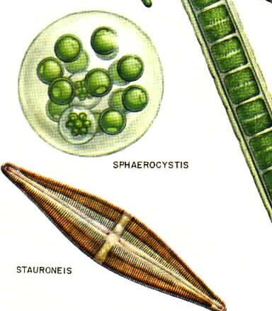
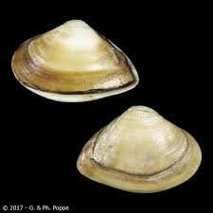
Chlorophyll
Interagency Ecological Program Status & Trends
2017-2018 Winter Season Report
Delta outflow is a major ecosystem driver and depends on natural hydrological variability and water management operations, including exports from the Delta and reservoir operations.
Suisun Bay
Water temperature affects fish and stuff
High temperatures lead to fish not doing so good and some harmfull algal blooms
Climate change will make things worse.
Clams really hit Suisun hard.
The Delta
San Pablo Bay
The delta is hot and stuff, but weltands might form thermal refugia
San Pablo bay didn’t have a big decrese in chlorophyll after the clam invasion, but it’s always been low.

Slide 4
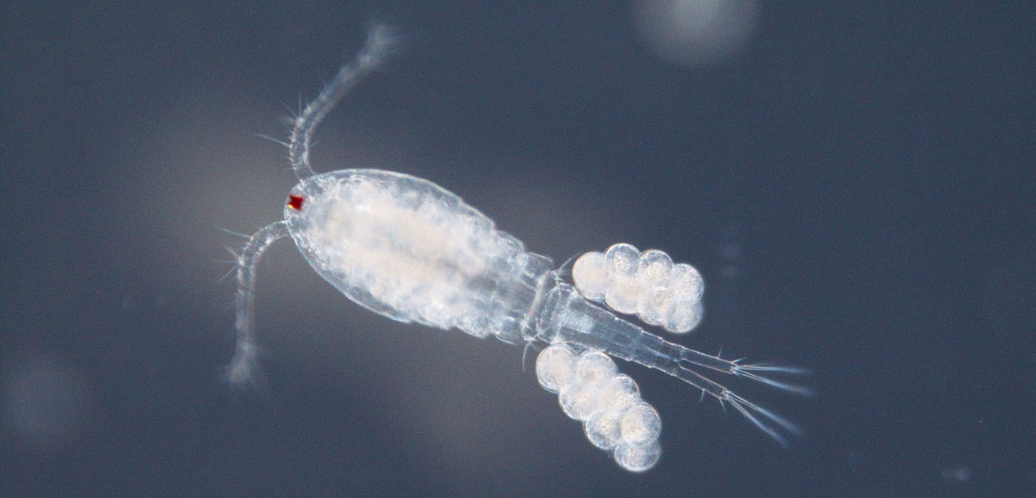
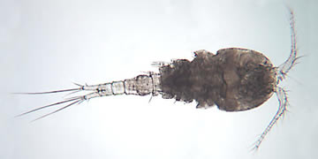
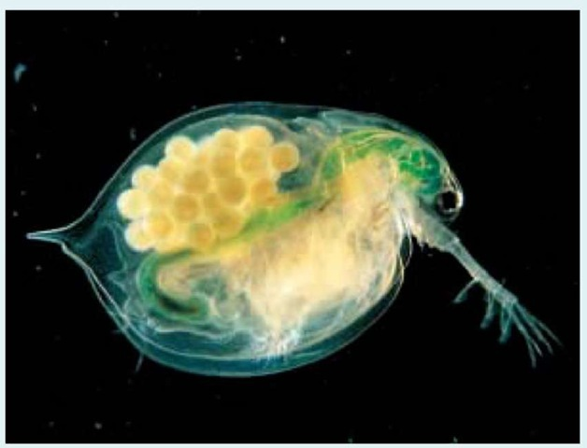
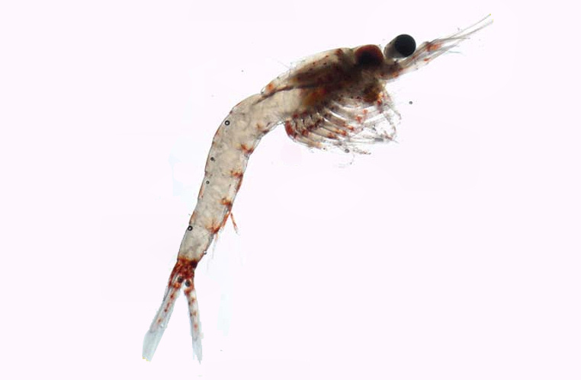
Zooplankton
Interagency Ecological Program Status & Trends
2017-2018 Winter Season Report
Delta outflow is a major ecosystem driver and depends on natural hydrological variability and water management operations, including exports from the Delta and reservoir operations.
Suisun Bay
Here’s some info on zooplankton
There uxed to be lots of mysids, but now its mostly cyclopoids
The Delta
San Pablo Bay
Lots of calanoid copepods
Not many zoops here

Slide 5
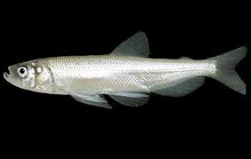
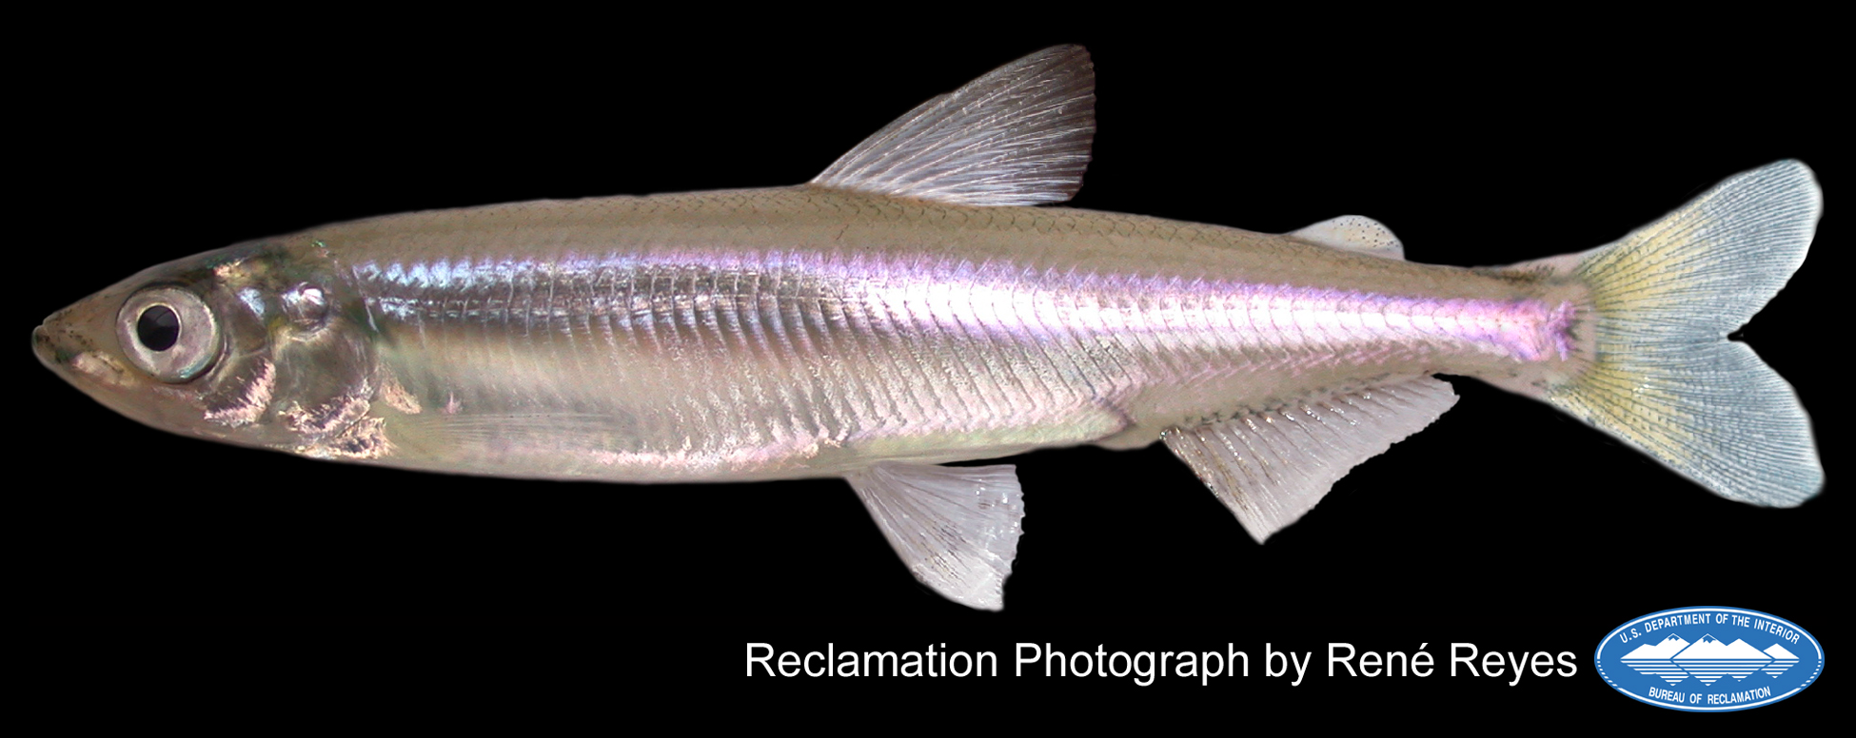
Smelt
Interagency Ecological Program Status & Trends
2017-2018 Winter Season Report
High outflow leads to increased abundance of longfin smelt.
High outflow increases abundance of Delta Smelt only in cooler years.
Longfin Smelt – Bay Study
Longfin smelt experienced sever declines in the early 2000s and have not recovered.
Bay study is the only IEP survey that samples throughout San Francisco Bay, making it especially good at pickup up Longfin Smelt.
Delta Smelt - SKT
Spring Kodiak Trawl samples throughout the Bay and Delta.
Delta smelt are not doing so great.

Slide 6
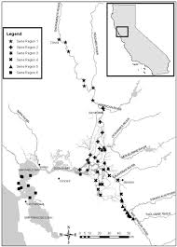
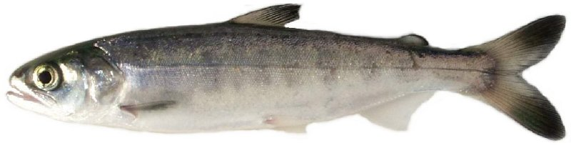
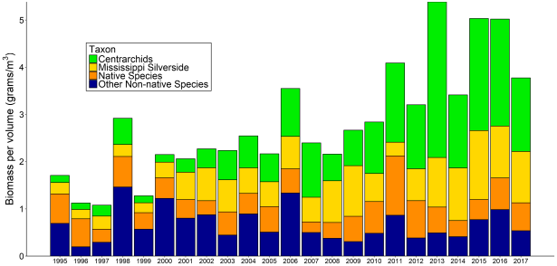
Salmon
Interagency Ecological Program Status & Trends
2017-2018 Winter Season Report
Salmon have been doing OK in recent years, though not amazing.
The drought was hard on them.
Red Bluff Diversion Dam
Preliminary estimates of passage by brood-year (BY) and run for unmarked juvenile Chinook salmon and steelhead trout captured by rotary-screw traps at Red Bluff Diversion Dam (RK391), Sacramento River, CA.
This sampling provides an estimate of production in the upper watershed.
DJFMP beach Seines
DJFMP’s beach seine data provides information on landscape patterns of juvenile chinook occurrence.
Researchers use these patterns to determine differences in salmon life-history.

Slide 7
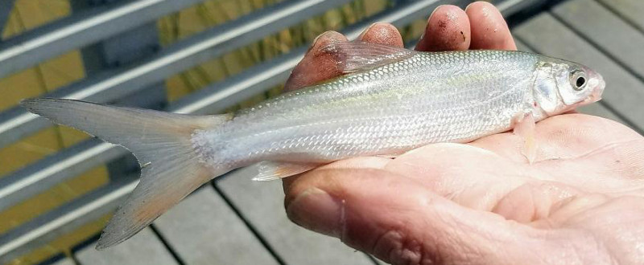
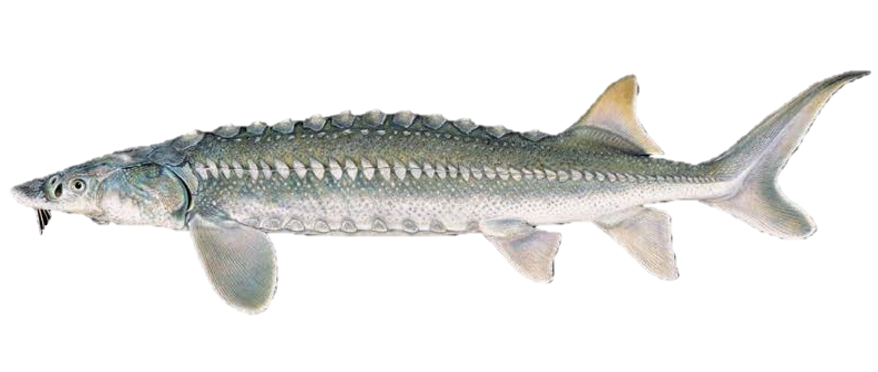
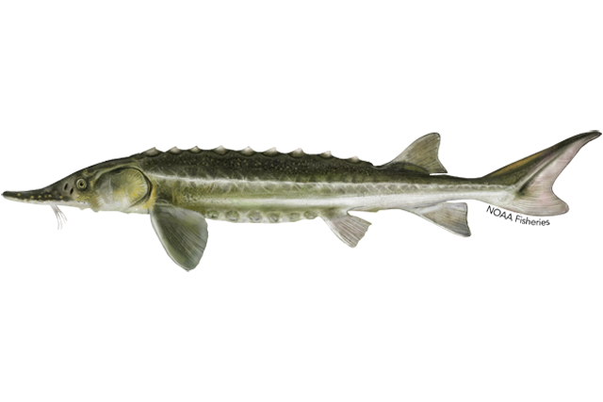
Other fish
Interagency Ecological Program Status & Trends
2017-2018 Winter Season Report
Splittail – Yolo bypass screw trap
Splittail spawn on flood plains such as the yolo bypass
They do really well in wet years.
The screw trap catches a lot of juvenile splittail in the spring after a wet year.
Sturgeon – Bay Study
Juvenile sturgeon are caught in Bay Study’s otter trawl
White sturgeon support a recreational fishery
Green sturgeon are listed as threatened.

